Slide 1

Clustering NBA Players
BY MITCHELL Hersey

Slide 2
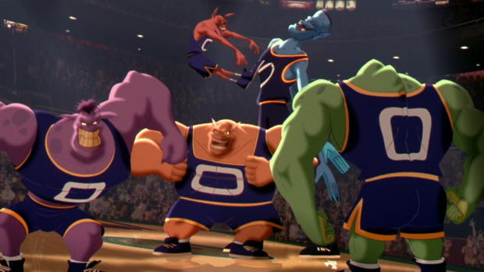
What are the standard positions in basketball?
Point Guard
Runs the offense
Smallest player on the court
High assists, low rebounds
John Stockton, Chris Paul
Shooting Guard
Scores the ball
Guards the best opposing guard
Michel Jordan, James Harden
Small Forward
Versatility
Many different styles of player
Lebron James, Kevin Durant
Power Forward
Strong and durable
Often can provide shooting range despite their heights
Tim Duncan, Kevin Garnett
Center
Tallest player on the court
Rebounds, Dunks, and Alley Oops
Shaquille O’Neal

Slide 3
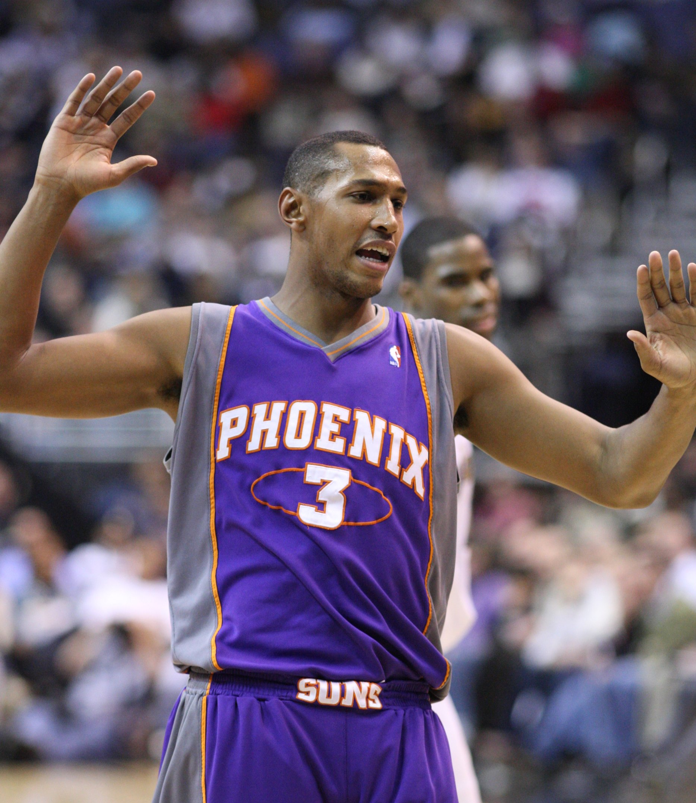
Is it really true though?
Does a player’s statistics actually support the existence of these five distinct positions?
Can you determine a player’s position strictly off of their box score?
…sometimes

Slide 4
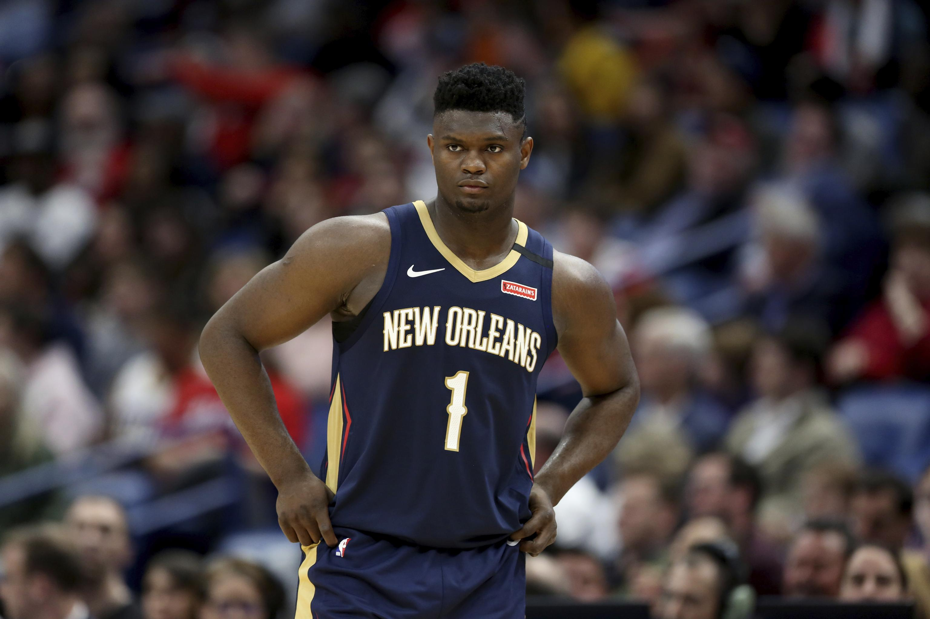
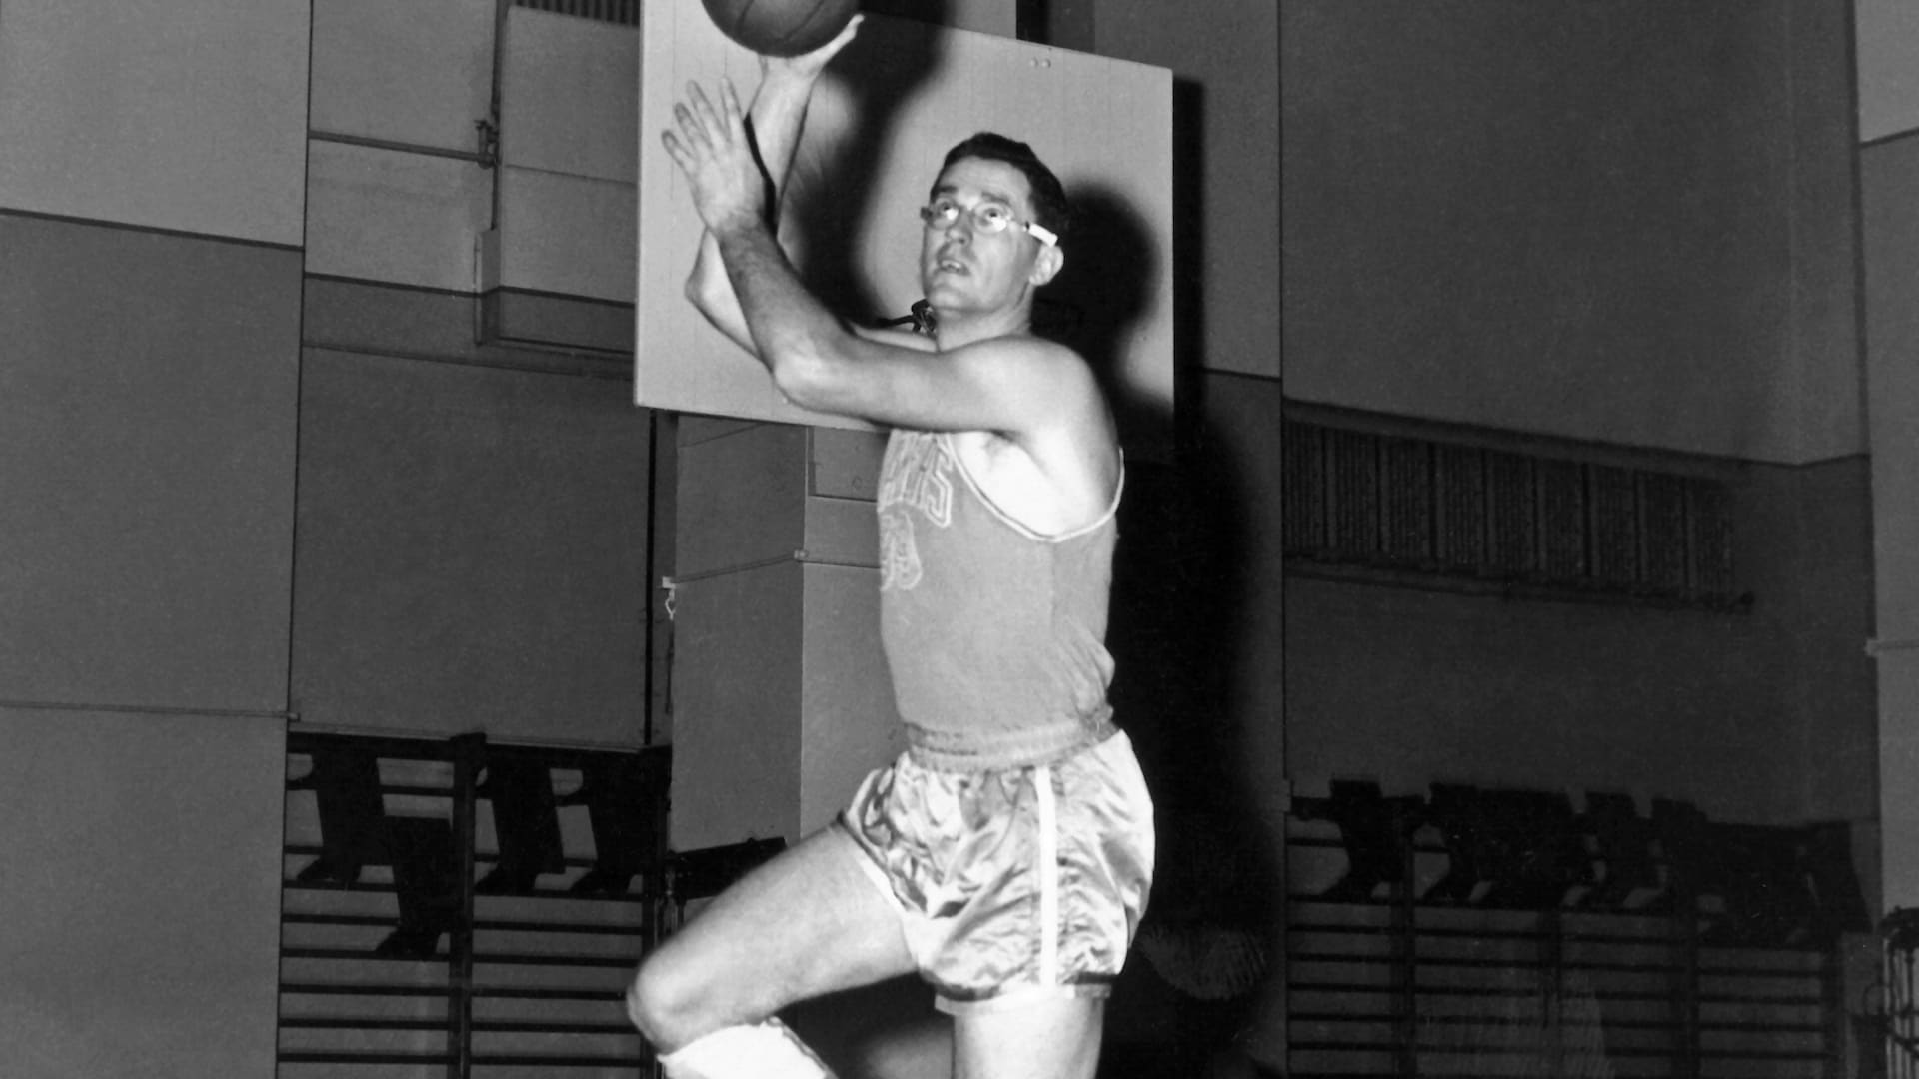
Clustering
There have been 24,690 individual player seasons from 1950 to 2017
Can this data create groups that resemble the traditional basketball positions?
What attributes should be used?
How many groups should there be?

Slide 5
What data is good data?
Threshold of 400+ minutes (~5 minutes per game)
Allows for a reasonable sample of the player’s on-court ability
Minutes first recorded in 1952
Counting stats normalized to per 36
Project a player’s contribution to a starting player’s workload
Standard practice in the statistics community
Rebounds, Steals, Blocks not recording until 1974
Turnovers recorded in 1978
Normalize stats again between 0 and 1

Slide 6
Attributes
1952 – 2017
1978 – 2017
Points
Assists
True Shooting %
Field Goal Attempts
Field Goal %
Three Point Attempts
Three Point %
Free Throw Attempts
Free Throw %
All of the attributes from the other clustering
Rebounds
Assists
Turnovers
Two Point Attempts
Two Point %
Usage %

Slide 7

K-Means Clustering (Lloyd’s Algorithm)
Designate K random samples as the initial centers of K clusters
Determine the closest cluster centroid for every season through Euclidean distance
Re-adjust the centroid to be the mean of the seasons supplied to it
Repeat until the centroids converge towards (approximately) a centroidal Voronoi tessellation

Slide 8

Random Sampling
Final clusters are ultimately most impacted by the initial seed for that cluster. A bad seed can mean lopsided clusters and thus unusable data.
Complete K-means multiple times and use the clustering with the lowest cumulative error between cluster centroid and assigned data.
Sum of Squares Error

Slide 9
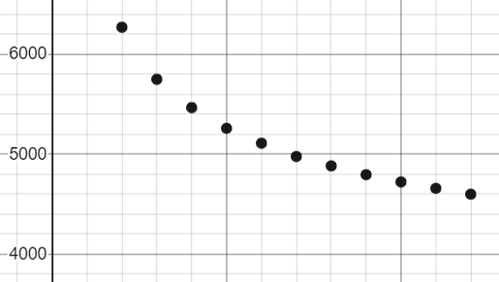
Choosing K
Luckily we already have a K to compare to but not everyone is that lucky
Is there a better K, can groupings be explained more accurately with more or fewer groups?
Find the middle ground between usable clusters (1) and clusters without error (n)
Turns out this middle ground is also about 5

Slide 10
Results (1978 – 2017)
Players cluster well into five groups, but now how you would think.
14,012 Eligible Seasons
Cluster 0 – ‘All-Star Big-men’
2,738 Seasons
~75% PF or C
Cluster 1 – ‘3 and D Wings (3 or D not guaranteed)’
3,534 Seasons
~63% SF or SG
Cluster 2 – ‘Traditional Point Guards’
2,414 Seasons
~66% PG
Cluster 3 – ‘GOATs’
2,206 Seasons
Cluster 4 – ‘Early 2000s European Big-man signed to take 6 fouls from Shaq’
3,120 Seasons
~86% PF or C

Slide 11
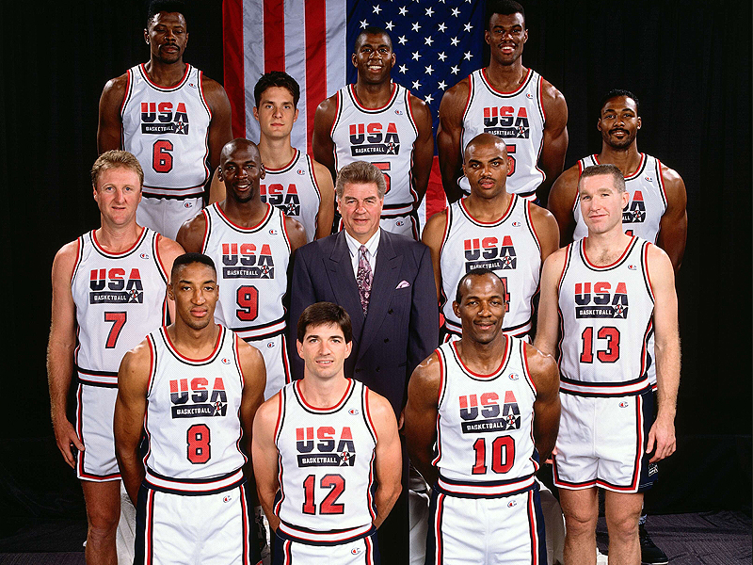
The Greatness of Clusters 0 and 3
666 Seasons by a Hall of Fame player
Cluster 0 has 301
Cluster 3 has 235
80% of all Hall of Fame seasons (1978 – 2017)
35% of total seasons
Every player of the 1992 Dream Team spent the majority of their careers in Clusters 0 or 3
John Stockton a notable exception (Cluster 2)
Cluster 3 also contains the majority of the careers of current superstars like Lebron James, Kevin Durant, Stephen Curry, James Harden, etc.

Slide 12
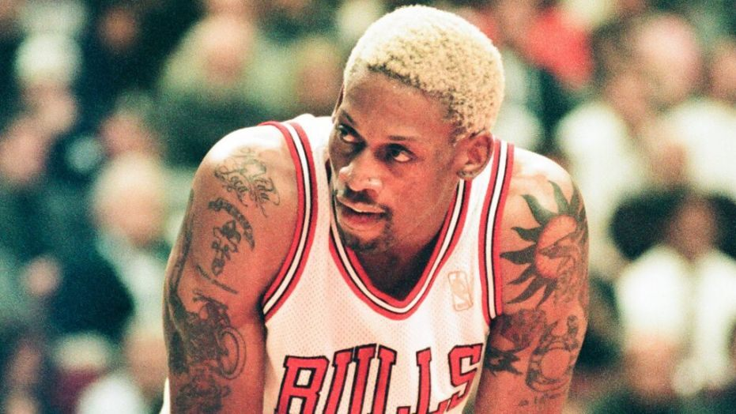
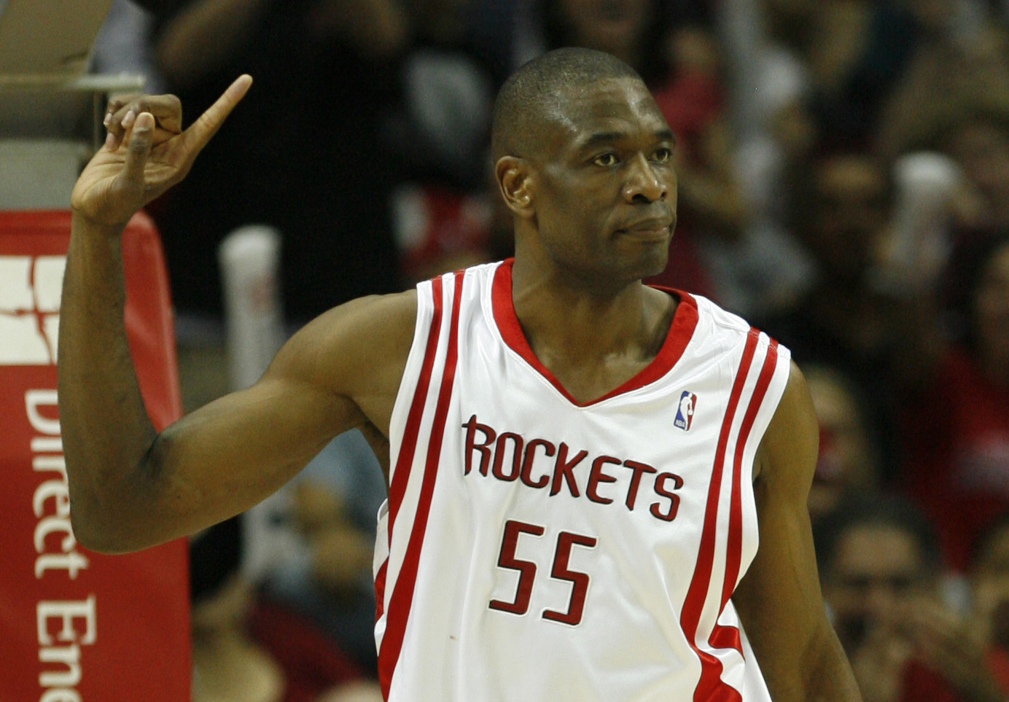
The Mediocrity of Cluster 4
Despite being the second largest group, there are only 44 seasons by a Hall of Famer in Cluster 4
1 by Phil Jackson who is in the hall as a coach
~6% of Hall of Fame seasons from 22% of seasons
Only 2 Hall of Famers spent the majority of their careers here (29 Seasons)
Dennis Rodman
Dikembe Mutombo

Slide 13
Extensions
Implementation of more clustering algorithms
Fuzzy C-means
Compare groupings between the algorithms
Analysis on this data set
Data Visualization
Ggobi sort of bricks my computer
Another clustering with even more attributes
Shot location (eg 0-3 ft, corner 3s)

Slide 14
Thank You!

